Slide 1
The Missing Piece:
How convertible bond Reshape Classic Portfolio Models
Cayde Xu

Slide 2
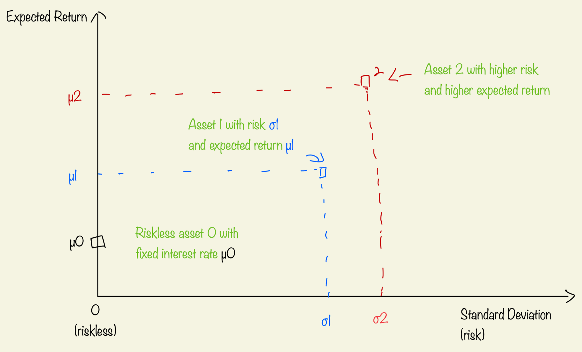
Plot the asset
“In the market, every asset carries its own level of risk and return.
By measuring risk using variance (or standard deviation), placing it on the x-axis,
and plotting expected return on the y-axis, we can construct a graph that visually replicates multiple assets.”
Can we construct a portfolio combining Asset 1 and Asset 2?
Can we utilize riskless asset?
Is this portfolio profitable?

Slide 3
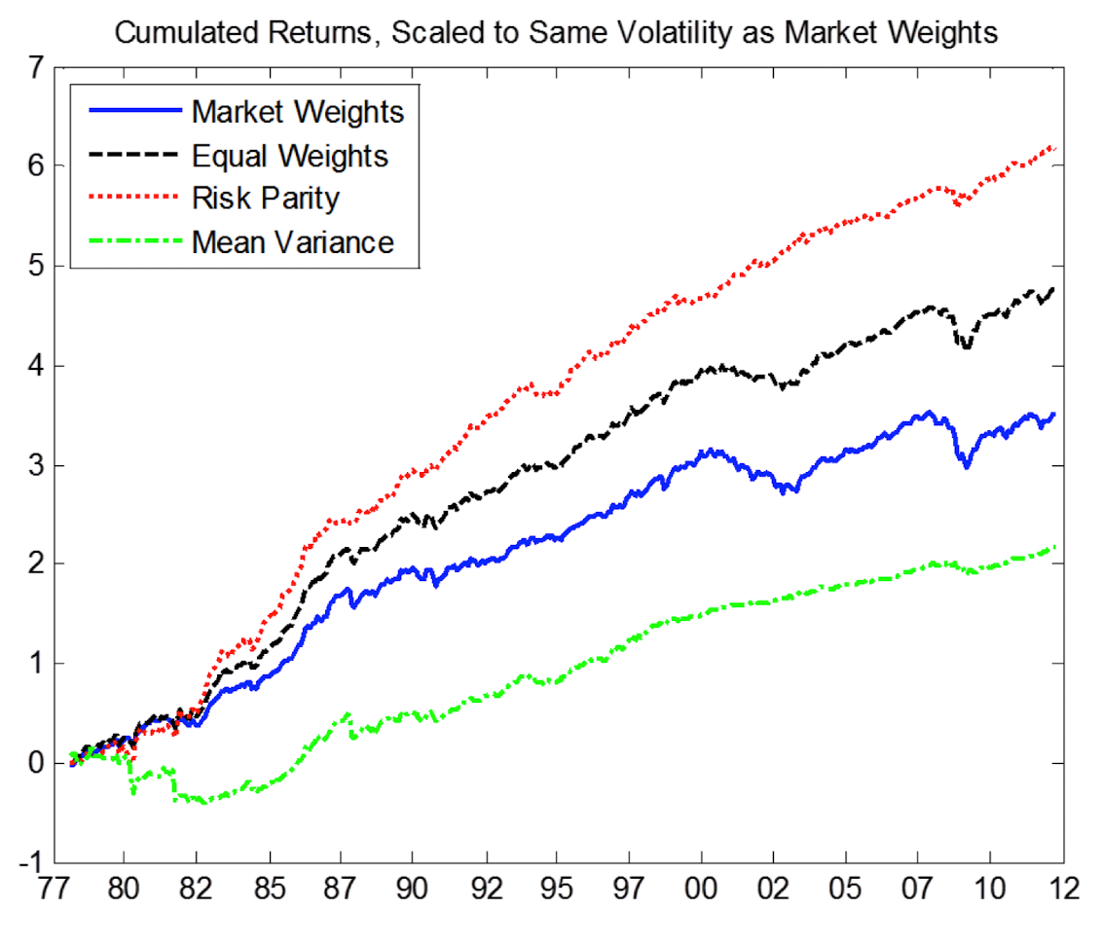
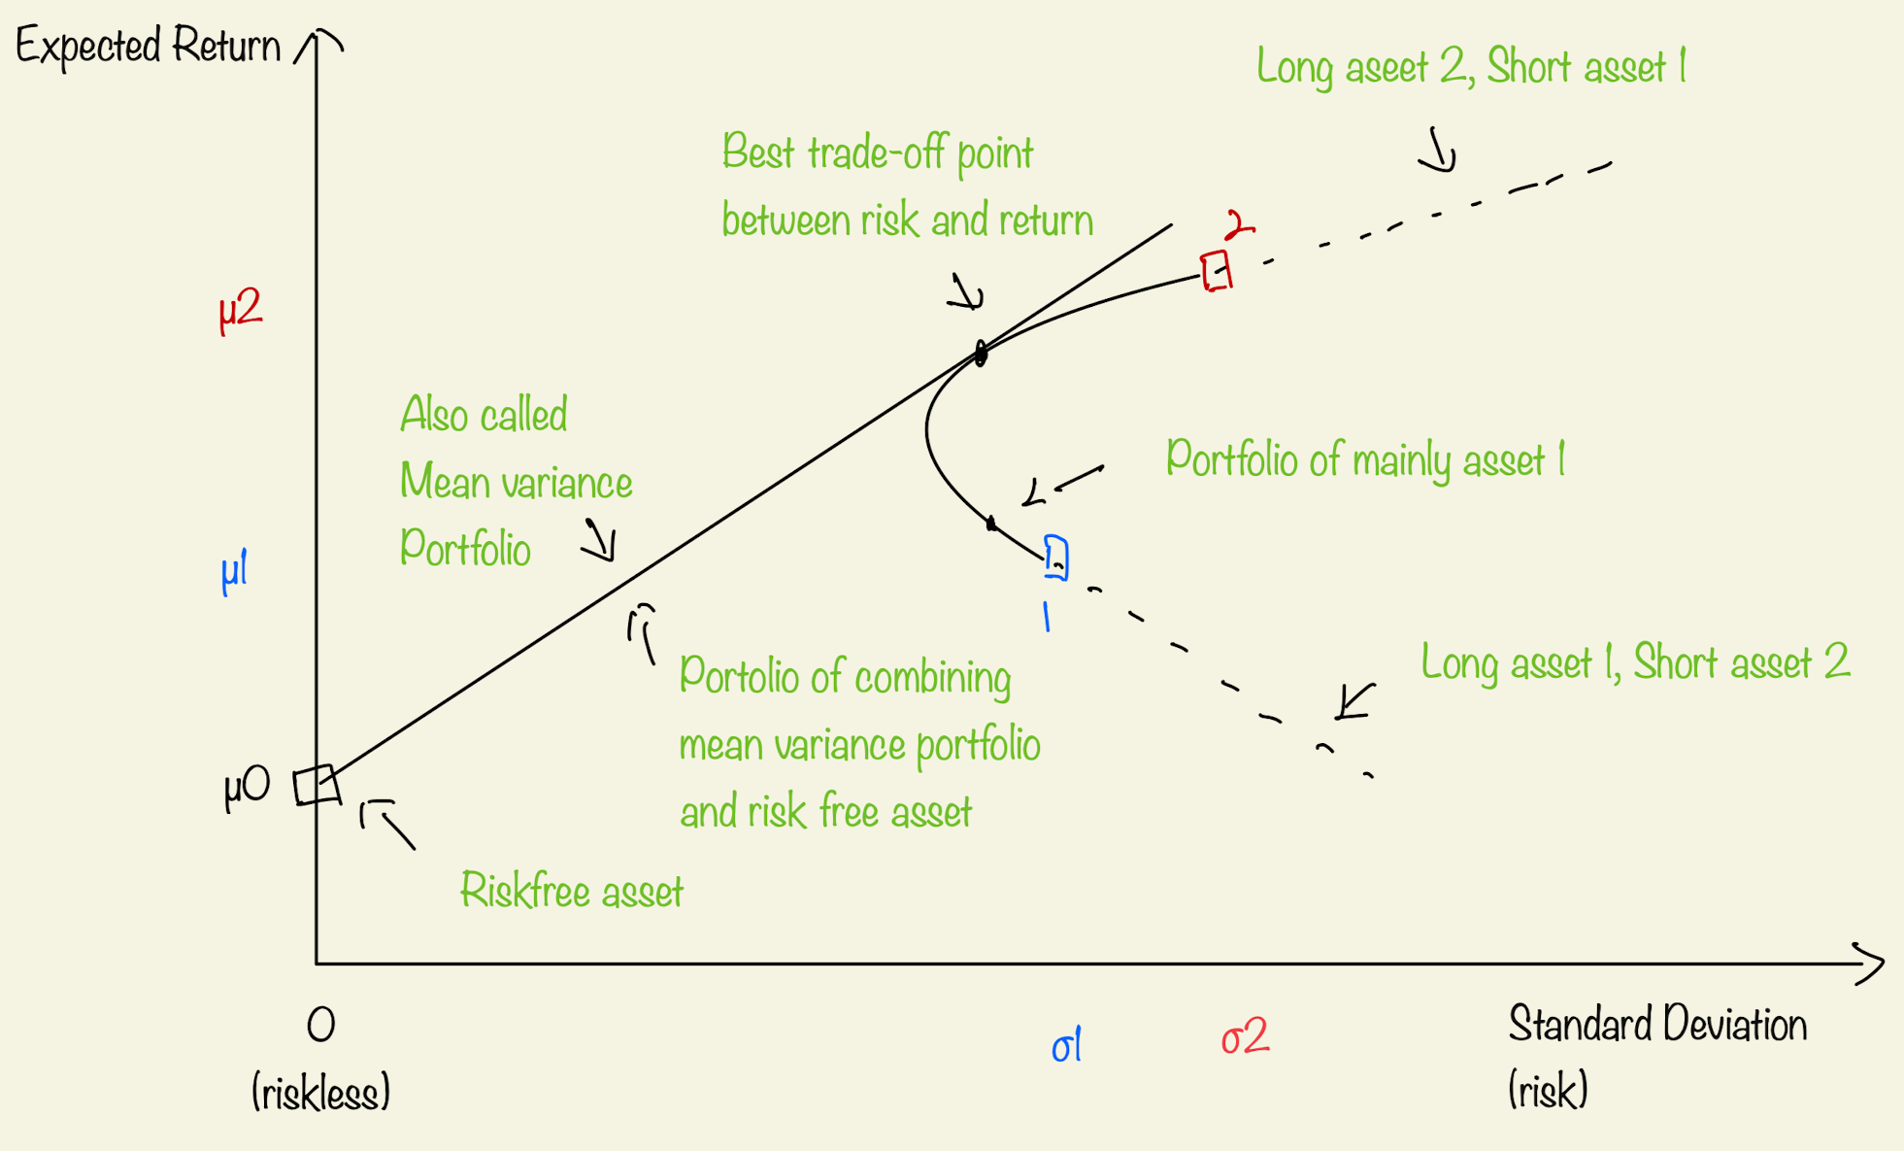
In the 1950s, Harry Markowitz developed the Mean Variance Investment strategy
When we construct a portfolio using Asset 1 and Asset 2, we
obtain a new expected return for each level of risk. By adjusting
the weight of each asset, the portfolio’s risk-return combinations
form a curve on the graph, which is called efficiency frontier.
However, there is an issue.
This mean Variance model is sensitive to input.
A small change in one asset’s mean can alter
the portfolio significantly and means are hard
to estimate as standard errors are large!
We can find the best trade-off between risk and return for 2 assets.
Combining with risk-free asset, the new portfolio maximize expected
return for a given level of risk. This is the mean variance portfolio,
which represent by all dots on the black straight line.

Slide 4
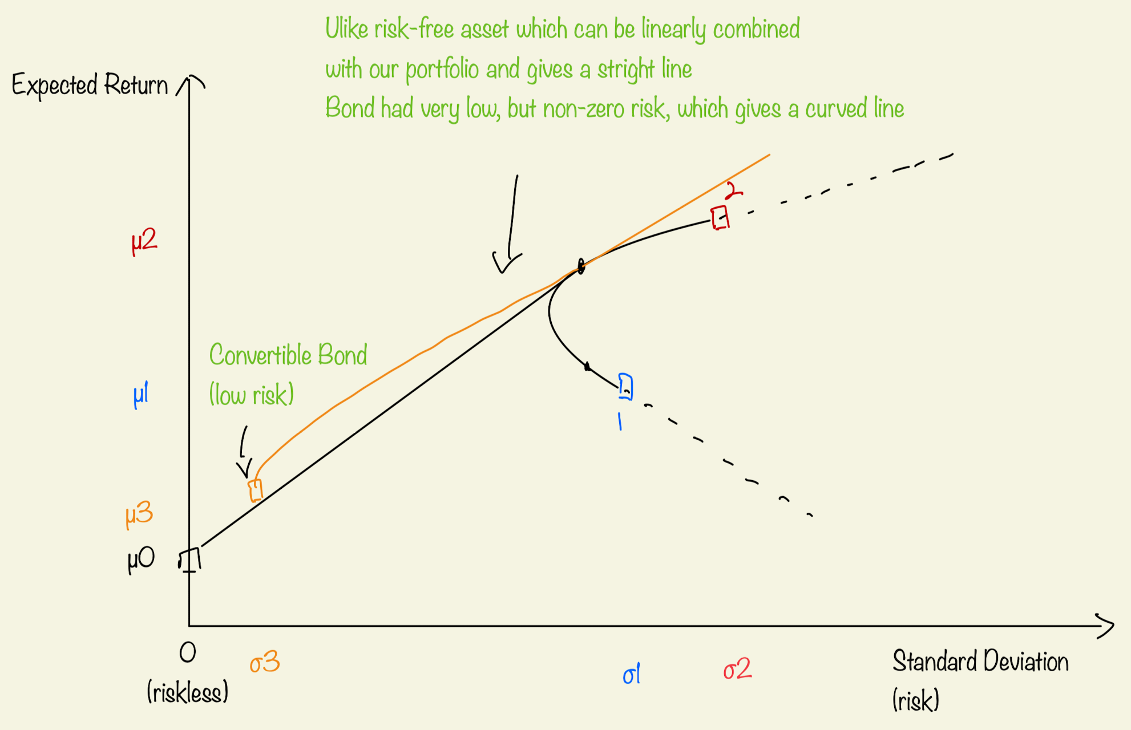
What if we introduce convertible bond?
Convertible bond:
Can be converted into a predetermined
amount of the underlying company’s
equity at certain times.
Why Consider Convertible Bonds?
Flexible Option to convert or hold
based on market conditions.
2. Controlled variables and focuses solely
on the decision to convert or not,
reducing disruptive factors compared
to previous model
3. Enhances overall portfolio
performance by providing downside
protection and upside potential.
As new convertible bond and might be correlated with asset 1 and asset 2, it generate a curve instead of straight line.
As it has higher expected return with small risk, the curve bends above the previous black Line at certain points.
We can choose any dots on orange line, which gives improved return for the same or lower risk.

Slide 5
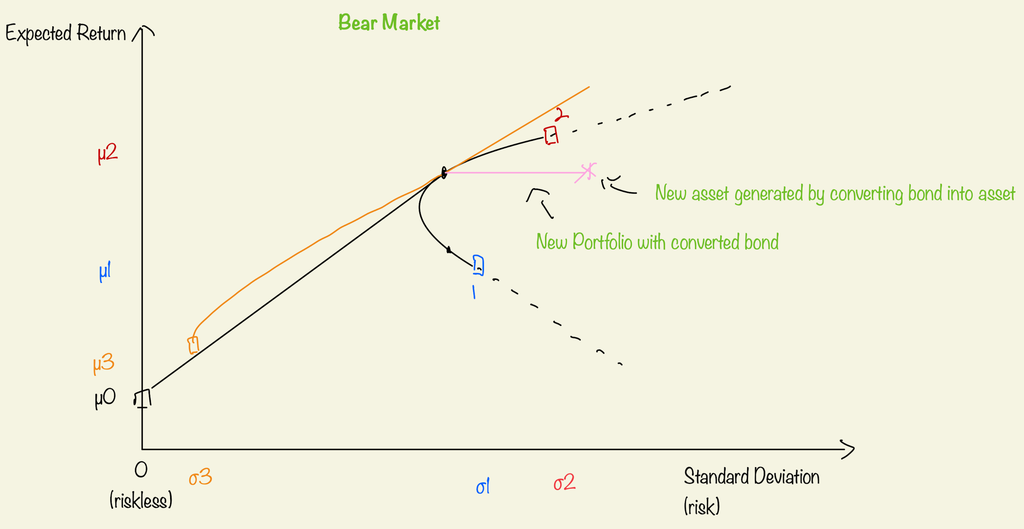
Now that a recession is approaching, is our portfolio still good?
In a bear market, when the stock price declines, convertible bonds do not generate any excess return after
conversion.
Fortunately, during a recession, bond prices are generally less affected than stock prices,
providing a degree of stability in the portfolio.
In this case, the most prudent strategy is to hold the bond until maturity to continue receiving interest and
principal repayment.

Slide 6
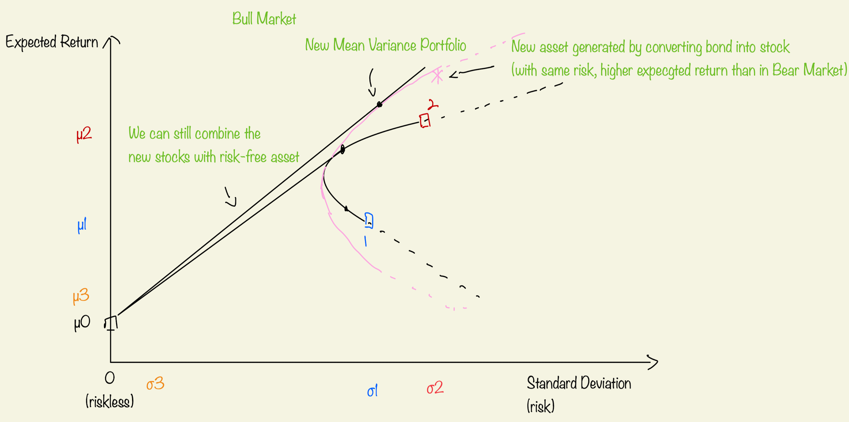
What happens if the market enters a bull phase?
As the stock price rises, converting the bond into equity becomes more attractive, offering a higher expected
return without increasing the level of risk.
Additionally, with the converted bond now contributing a third stock to the portfolio, the efficient frontier expands,
allowing for portfolios with even higher expected returns.
When we combine this new frontier with the risk-free asset, the resulting new black line shift upward,
indicating improved overall portfolio performance after conversion.

Slide 7
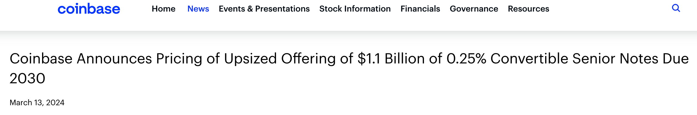
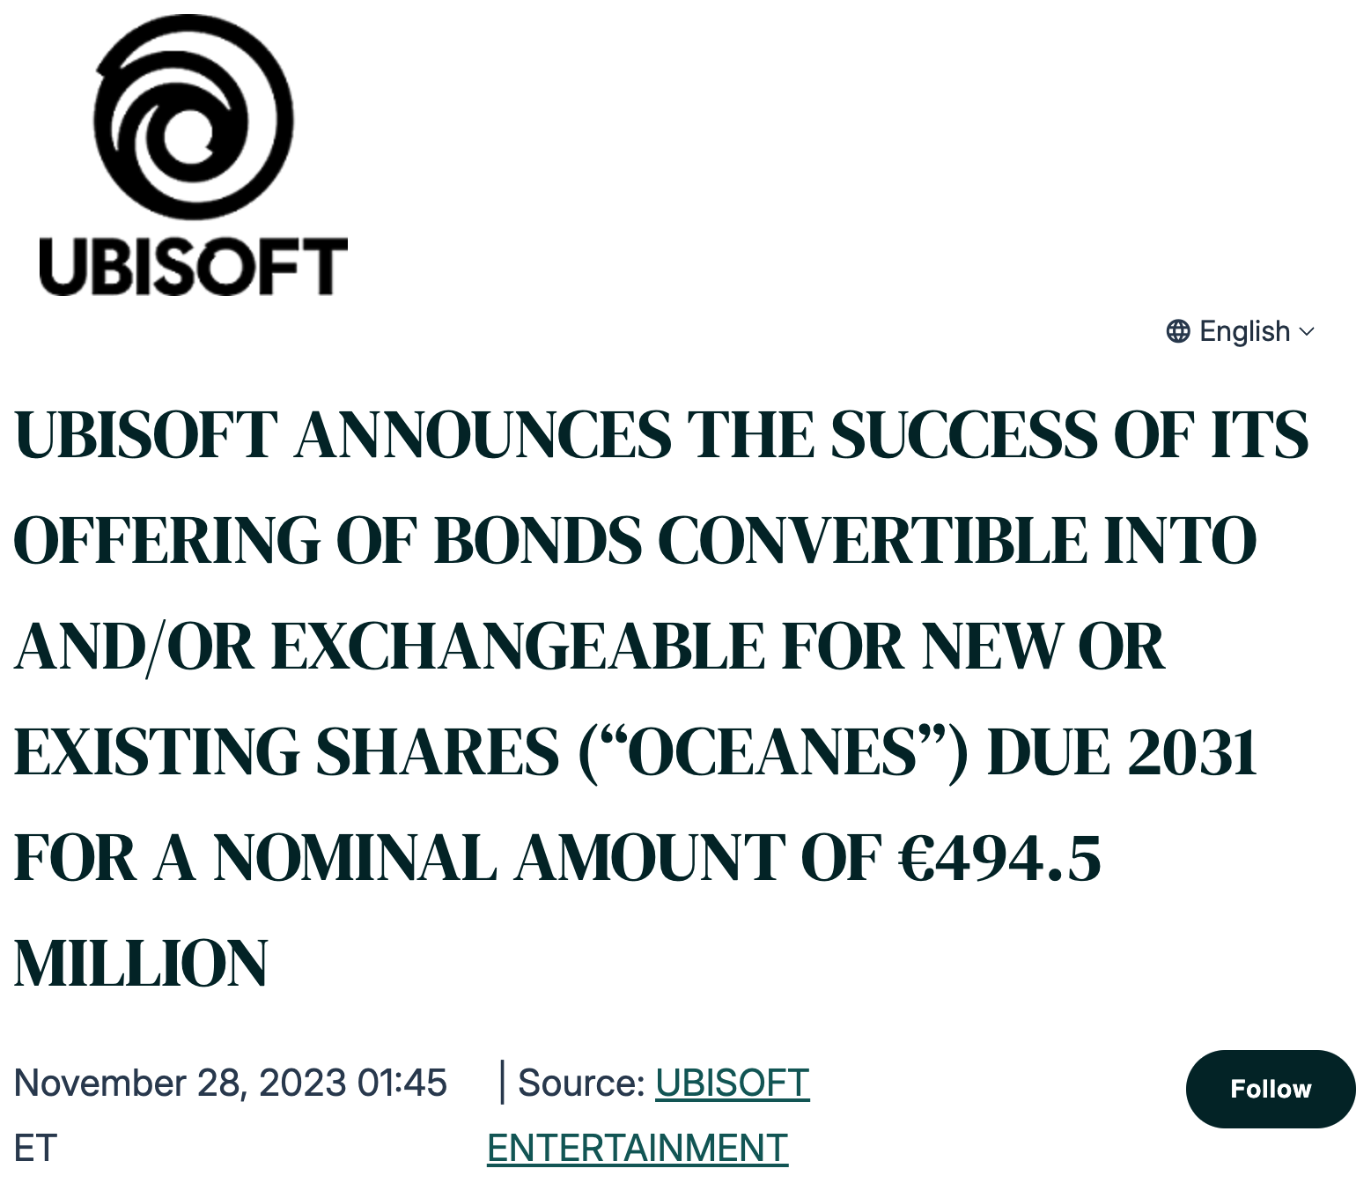
Is this strategy practical? Do companies issue a sufficient volume of convertible bonds for us to use
them as a hedging tool in our mean variance portfolio?
Companies—particularly growth firms with strong stock performance
(like Coinbase and Ubisoft who recently issue convertible bonds )
—often prefer to issue convertible bonds for several reasons:
Lower Financing Costs: Convertible bonds usually come with lower coupon
rates than traditional bonds, as the embedded option to convert into equity
provides additional value to investors.
This helps companies reduce their interest expenses.
2. Attractive to Investors: A high stock price makes the conversion feature
more attractive, offering investors the downside protection of a bond
along with the upside potential of equity participation.
3. Easier access to Capital: For early-stage growth companies with limited
credit history, convertible bonds can be easier to issue than traditional debt or new equity,
making them an effective tool for raising capital.

Slide 8
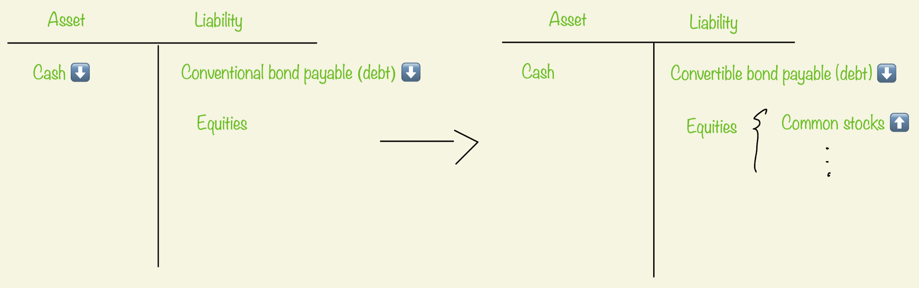
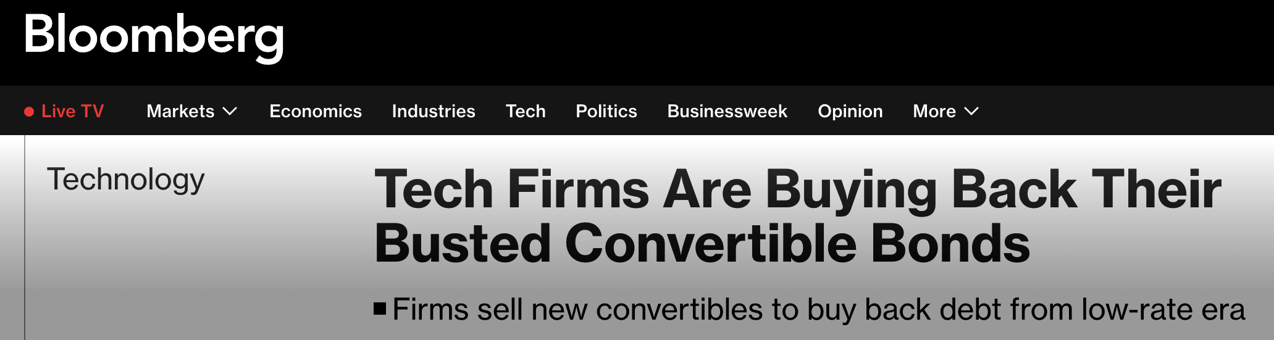
When a bond matures, conventional bonds remain liabilities that must be repaid in full, creating a cash flow
burden for the company.
In contrast, if the bond is convertible and investors choose to convert, it transforms into equity—eliminating
the debt, improving the debt-to-equity ratio, and reducing the company’s cash flow obligations.
Tech companies often turn to convertible bonds
as a preferred tool for refinancing.

Slide 9
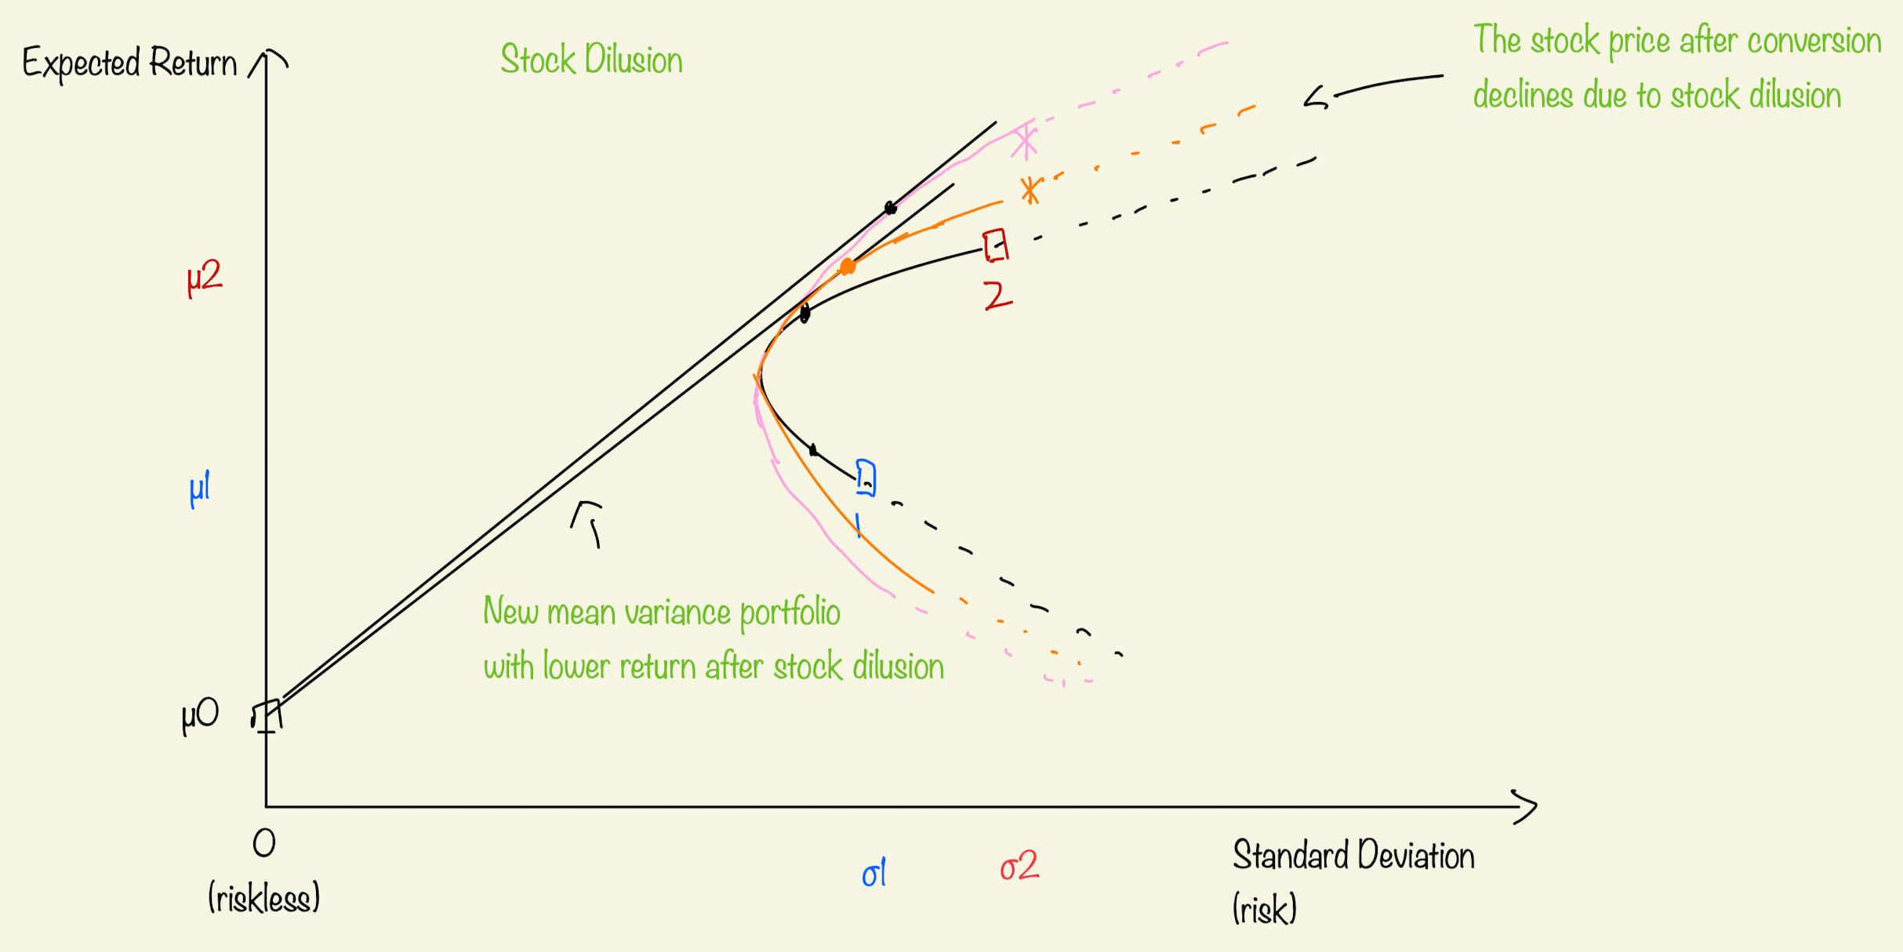
However, our mean-variance portfolio may face certain disadvantages under specific conditions.
If companies issue more convertible bonds and many investors choose to convert them into stock,
the resulting increase in shares outstanding can lead to stock dilution.
This dilution may put downward pressure on the stock price, potentially reducing the overall return of the portfolio.
Similarly, if the stock price rises sharply, the company may initiate a mandatory conversion,
which can limit our upside potential.

Slide 10
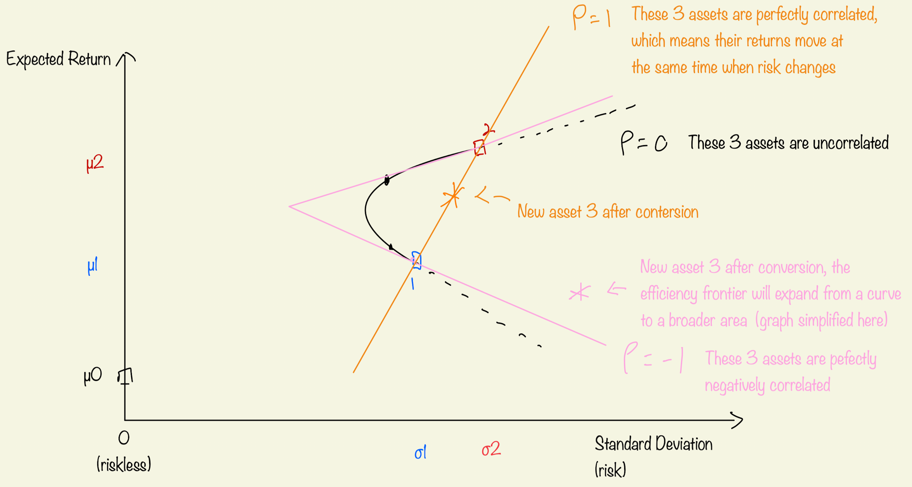
Remark: After bond conversion, the shape of efficiency frontier might change
After the bond is converted, our portfolio may now include three or more assets. Depending on the correlation
between these assets, the shape of the efficient frontier will change significantly—potentially resulting in a
completely different mean variance portfolio. As investors, our goal is to build a portfolio with stable returns,
which means including assets that are uncorrelated or even negatively correlated. Therefore, it’s important to
carefully consider the correlation of the owned stock when deciding whether to convert a bond.
For example, if the convertible bond was issued by a high-growth tech company, we might choose not to
convert if our portfolio already holds a bunch of tech stocks. Adding another tech stock could increase
concentration risk and amplify losses during a sector downturn.

Slide 11
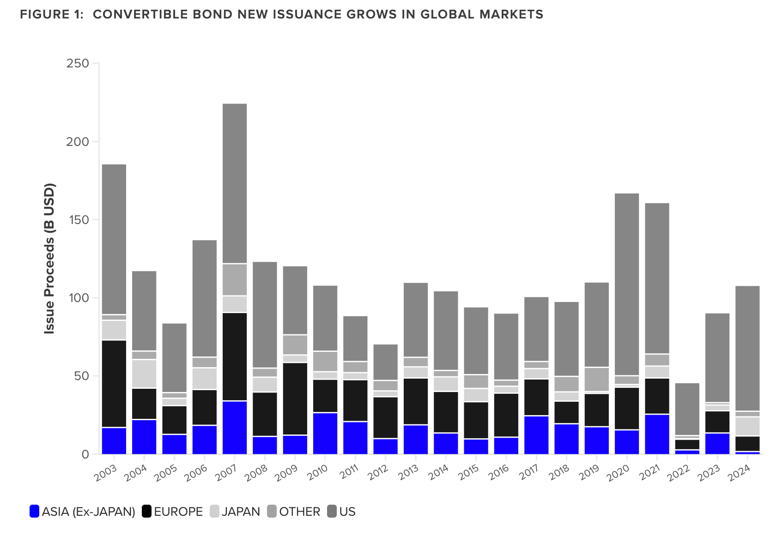
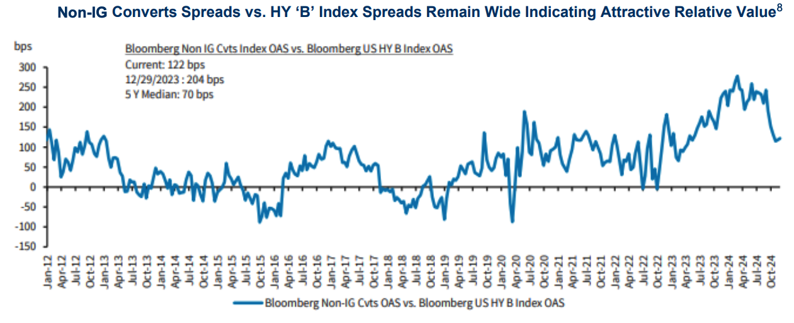
What Is the Current Market Condition for Convertible Bonds?
“Signs of recovery”
“Healthy spread relative to conventional bonds”
“Volume growth”

Slide 12
Conclusion
Convertible bonds and the classical mean-variance portfolio complement each other well.
Convertible bonds help reduce input estimation errors by offering a built-in option to convert or not,
It also provide downside protection and upside potential—key enhancements for a mean-variance strategy.
At the same time, the mean-variance approach helps compensate for the typically lower yield of convertible
bonds.
With the recovery of both U.S. and global convertible bond markets, and the emergence of more growth
companies, the potential of combining these two strategies is greater than ever.

Slide 13
Reference
Page 7 coinbase report
https://investor.coinbase.com/news/news-details/2024/Coinbase-Announces-Pricing-of-Upsized-Offering-of-
1.1-Billion-of-0.25-Convertible-Senior-Notes-Due-2030/default.aspx?
Page 7 Ubisoft report
https://www.globenewswire.com/news-release/2023/11/28/2786621/0/en/UBISOFT-ANNOUNCES-THE-
SUCCESS-OF-ITS-OFFERING-OF-BONDS-CONVERTIBLE-INTO-AND-OR-EXCHANGEABLE-FOR-NEW-
OR-EXISTING-SHARES-OCEANES-DUE-2031-FOR-A-NOMINAL-AMOUNT-OF-494-5-MILLION.html?
Page 8 Report
https://www.bloomberg.com/news/articles/2024-03-22/tech-firms-are-buying-back-their-busted-convertible
-bonds?embedded-checkout=true
Page 11 Charts
https://ssi-invest.com/wp-content/uploads/2025/01/Convertible-Bond-2024-Review-and-2025-Outlook.pdf?
https://www.lseg.com/en/insights/data-analytics/convertible-bonds-make-a-comeback?
Mean Variance portfolio general idea
Chakravarty, Satya R. “Portfolio Management: The Mean-Variance Approach.” An Outline of Financial Economics,
Anthem Press, 2013, pp. 221–52. JSTOR, http://www.jstor.org/stable/j.ctt1gxpb0j.17. Accessed 22 Apr. 2025.

